Slide 1
Lesson 21
Managing Dependencies

Slide 2
Objective
After completing this lesson, you should be able to do the following:
  Track procedural dependencies
  Predict the effect of changing a database object on procedures and functions
  Manage procedural dependencies
  Manage local and remote dependencies

Slide 3
Lesson Agenda
  Schema object dependencies
  Direct and indirect dependencies
  Fine-grained dependency management
  Managing remote dependencies
  Revalidating PL/SQL program units
  Package dependency management

Slide 4
What are Dependencies in a Schema?
  Dependency refers to a situation where one schema object depends on another object for its definition.
  Examples
    There is a dependency between a view and the set of tables on which it is defined.
    There is a dependency between the procedure and the tables on which the procedure is defined.

Slide 5


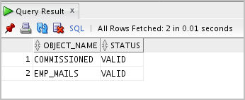
How Dependencies Work?
Let us create the following views in the HR schema:
CREATE OR REPLACE VIEW commissioned AS SELECT first_name, last_name, commission_pct FROM employees WHERE commission_pct > 0.00;
CREATE OR REPLACE VIEW emp_mails AS SELECT first_name, last_name, email FROM employees;
SELECT object_name, status
FROM user_objects
WHERE object_type = 'VIEW'
ORDER BY object_name;

Slide 6

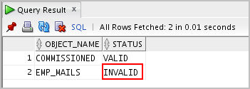
How Dependencies Work?
  Let us modify the email column of the employees table:
ALTER TABLE employees MODIFY email VARCHAR2(100);
And check the state of the views:
SELECT object_name, status
FROM user_objects
WHERE object_type = 'VIEW'
ORDER BY object_name;
You can see that after the email column in the employees table is modified, the status emp_mails view has become invalid.

Slide 7
Dependent and Referenced Objects
Some types of schema objects can reference other objects in their definitions.
For example:
  A view is defined by a query that references tables.
    View is a dependent object.
    Tables are referenced objects.

Slide 8
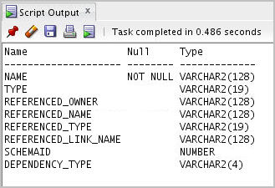

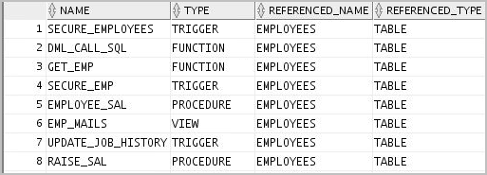
Querying Object Dependencies:
Using the USER_DEPENDENCIES View
desc user_dependencies;
SELECT name, type, referenced_name, referenced_type
FROM user_dependencies
WHERE referenced_name IN ('EMPLOYEES','EMP_VW' );

Slide 9
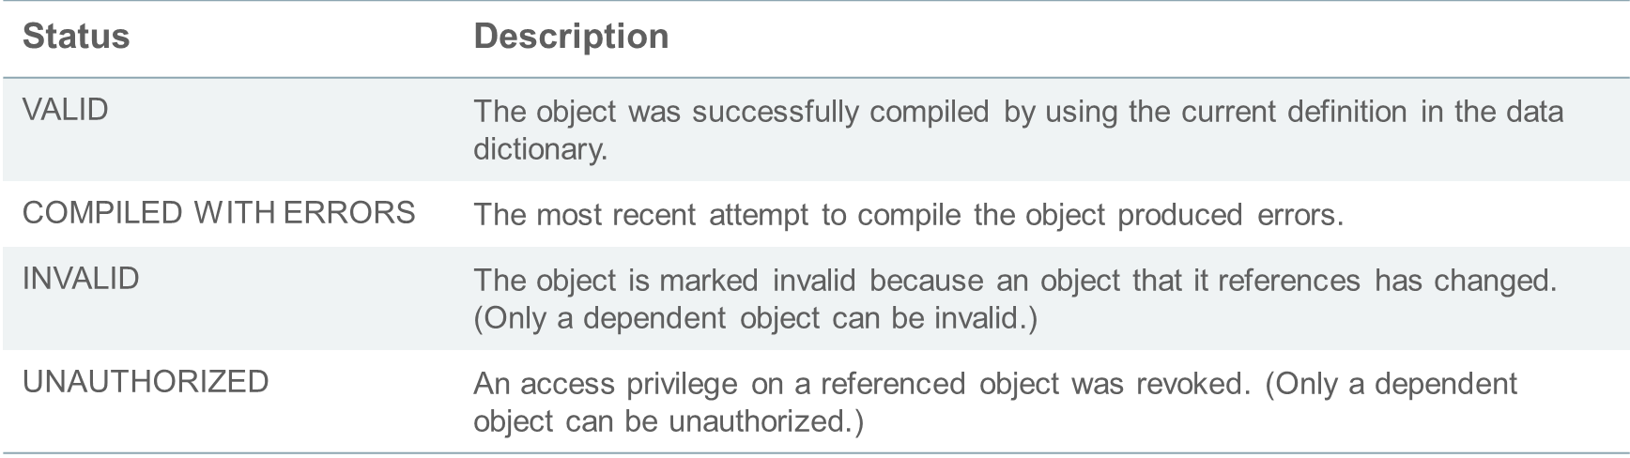
Querying an Object’s Status
Every database object has one of the following status values:

Slide 10

Categorizing Dependencies
  Local dependencies – Both the referenced and dependent objects are on the same database. Oracle Database manages them implicitly. There are two types of dependencies in local dependencies using the internal tables.
    Direct dependencies
    Indirect dependencies
  Remote dependencies – The referenced and dependent objects are on different nodes across the network. Oracle Database uses different mechanisms to manage remote dependencies, depending on the objects involved.

Slide 11


Direct Dependencies
  When a view V is defined on a table T, there is a direct dependency of the view V on the table T.
  Direct dependents are invalidated only by changes to the referenced objects that affect them.
View dependent on Table
View (V)
Table(T)

Slide 12
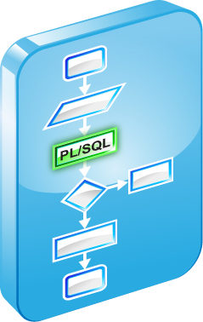

Indirect Dependencies
  Consider a PL/SQL program unit dependent on the view V, which in turn is dependent on the table T. The PL/SQL program unit is indirectly dependent on the table T.
  Indirect dependents can be invalidated by changes to the referenced object that do not affect them.
  The PL/SQL unit may be invalidated if there is a modification to the table.
PL/SQL unit dependent on view
View dependent on table
View (V)
Table(T)

Slide 13

Displaying Direct and Indirect Dependencies
  Run the utldtree.sql script that creates the objects that enable you to display the direct and indirect dependencies.
  This script creates four objects, as given below:
    A table deptree_temptab to hold dependency data
    A procedure deptree_fill to populate the table
    Two views – deptree and ideptree – to select and format dependency data from the populated table
@/home/oracle/labs/plpu/labs/utldtree.sql

Slide 14

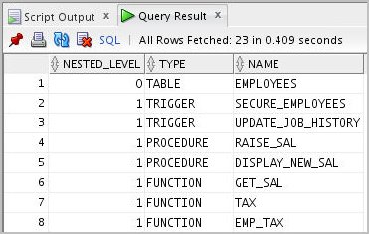
Displaying Direct and Indirect Dependencies
  Execute the DEPTREE_FILL procedure.
  Display the dependencies
EXECUTE deptree_fill('TABLE', 'ORA61', 'EMPLOYEES')
SELECT nested_level, type, name
FROM deptree
ORDER BY seq#;

Slide 15



Fine-Grained Dependency Management
CREATE OR REPLACE VIEW commissioned AS SELECT first_name, last_name, commission_pct FROM employees WHERE commission_pct > 0.00;
CREATE OR REPLACE VIEW emp_mails AS SELECT first_name, last_name, email FROM employees;
SELECT object_name, status
FROM user_objects
WHERE object_type = 'VIEW'
ORDER BY object_name;
ALTER TABLE employees MODIFY email VARCHAR2(100);
SELECT object_name, status
FROM user_objects
WHERE object_type = 'VIEW'
ORDER BY object_name;

Slide 16
Fine-Grained Dependency Management
  Starting with Oracle Database 11g, dependencies are now tracked at the level of element within unit.
  Element-based dependency tracking covers the following:
    Dependency of a single-table view on its base table
    Dependency of a PL/SQL program unit (package specification, package body, or subprogram) on the following:
      Other PL/SQL program units
      Tables
      Views

Slide 17


Fine-Grained Dependency Management: Example 1
CREATE TABLE t2 (col_a NUMBER, col_b NUMBER, col_c NUMBER);
CREATE VIEW v AS SELECT col_a, col_b FROM t2;
SELECT ud.name, ud.type, ud.referenced_name,
ud.referenced_type, uo.status
FROM user_dependencies ud, user_objects uo
WHERE ud.name = uo.object_name AND ud.name = 'V';
ALTER TABLE t2 ADD (col_d VARCHAR2(20));
SELECT ud.name, ud.type, ud.referenced_name,
ud.referenced_type, uo.status
FROM user_dependencies ud, user_objects uo
WHERE ud.name = uo.object_name AND ud.name = 'V';

Slide 18

Fine-Grained Dependency Management: Example 1
ALTER TABLE t2 MODIFY (col_a VARCHAR2(20));
SELECT ud.name, ud.referenced_name, ud.referenced_type, uo.status
FROM user_dependencies ud, user_objects uo
WHERE ud.name = uo.object_name AND ud.name = 'V';

Slide 19


Fine-Grained Dependency Management: Example 2
CREATE OR REPLACE PACKAGE pkg IS
PROCEDURE proc_1;
END pkg;
/
CREATE OR REPLACE PROCEDURE p IS
BEGIN
pkg.proc_1();
END p;
/
CREATE OR REPLACE PACKAGE pkg
IS
PROCEDURE proc_1;
PROCEDURE unheard_of;
END pkg;
/

Slide 20
Guidelines for Reducing Invalidation
To reduce invalidation of dependent objects:
  Add new items to the end of the package
  Reference each table through a view

Slide 21
Object Revalidation
  An object that is not valid when it is referenced must be validated before it can be used.
  Validation occurs automatically when an object is referenced; it does not require explicit user action.
  Revalidation may not happen automatically if:
    The object is compiled with errors
    The object is an unauthorized object
    The object is an invalid object

Slide 22





Remote Dependencies
  The referenced and dependent objects are on different nodes across the network.
  Oracle Database does not manage dependencies among remote schema objects other than local-procedure-to-remote-procedure dependencies

Slide 23


Managing Remote Procedure Dependencies
Mechanisms used for managing remote procedure dependencies are:
  Timestamp checking
  Signature checking

Slide 24
Setting the REMOTE_DEPENDENCIES_MODE Parameter
  You can define whether a remote procedure call should undergo Timestamp checking or Signature checking by setting the REMOTE_DEPENDENCIES_MODE parameter.
    At the system level:
    ALTER SYSTEM SET REMOTE_DEPENDENCIES_MODE = TIMESTAMP | SIGNATURE
    At the session level:
    ALTER SESSION SET REMOTE_DEPENDENCIES_MODE = TIMESTAMP | SIGNATURE
    As an init.ora parameter:
    REMOTE_DEPENDENCIES_MODE = TIMESTAMP |
    SIGNATURE
  If the REMOTE_DEPENDENCIES_MODE parameter is not specified, either in the init.ora parameter file or by using the ALTER SESSION or ALTER SYSTEM DDL statements, TIMESTAMP is the default value.

Slide 25





Timestamp Checking
Remote procedure B:
compiles and is VALID
at 8:00 AM

Slide 26

Timestamp Checking
TIMESTAMP of A
Record
TIMESTAMP of B
TIMESTAMP of B
Local procedure A: VALID
Remote procedure B: VALID

Slide 27


Timestamp Checking
TIMESTAMP
comparison
TIMESTAMP of A
TIMESTAMP of B
TIMESTAMP of B
Local procedure A: VALID
Remote procedure B: VALID

Slide 28

Timestamp Checking
Remote procedure B:
Recompiles and is VALID
at 11:00 AM

Slide 29


Timestamp Checking
TIMESTAMP
comparison
TIMESTAMP of B
TIMESTAMP of B
Local procedure A: INVALID
Remote procedure B: VALID

Slide 30
Signature Checking
  The signature of a procedure is:
    The name of the procedure
    The data types of the parameters
    The modes of the parameters
  The signature of the remote procedure is saved in the local procedure.
  When executing a dependent procedure, the signature of the referenced remote procedure is compared.

Slide 31
Revalidating PL/SQL Program Units
You revalidate a PL/SQL program unit by recompiling it. There are two ways of recompiling:
  Implicit runtime recompilation
    Local dependencies are resolved implicitly
  Explicit recompilation with the ALTER statement
    Here is the syntax for using the ALTER statement.
  ALTER PROCEDURE|FUNCTION | TRIGGER|PACKAGE [SCHEMA.]object_name COMPILE;

Slide 32
Unsuccessful Recompilation
Recompiling-dependent procedures and functions are unsuccessful when:
  The referenced objects are compiled with errors
  The referenced objects are dropped or renamed
  The data type of the referenced column is changed
  The referenced column is dropped
  A referenced view is replaced by a view with different columns
  The parameter list of a referenced procedure is modified

Slide 33
Successful Recompilation
Recompiling-dependent procedures and functions are successful if:
  The referenced table has new columns
  The data type of referenced columns has not changed
  A private table is dropped, but a public table that has the same name and structure exists
  The PL/SQL body of a referenced procedure has been modified and recompiled successfully

Slide 34
Recompiling Procedures
Minimize dependency failures by:
  Declaring records with the %ROWTYPE attribute
  Declaring variables with the %TYPE attribute
  Querying with the SELECT * notation
  Including a column list with INSERT statements

Slide 35



Packages and Dependencies: Subprogram References the Package
Package
specification
Procedure A
declaration
Standalone
procedure
Package
body
Procedure A
declaration
.
.
.
.
Package
definition
changed

Slide 36
Packages and Dependencies:
Package Subprogram References Procedure
Package
specification
Procedure A
declaration
Package
body
Procedure A
declaration
.
.
.
.
Standalone
procedure definition
changed

Slide 37
Quiz
You can display direct and indirect dependencies by running the utldtree.sql script, populating the DEPTREE_TEMPTAB table with information for a particular referenced object, and querying the DEPTREE or IDEPTREE views.
  True
  False

Slide 38
Summary
In this lesson, you should have learned how to:
  Track procedural dependencies
  Predict the effect of changing a database object on procedures and functions
  Manage procedural dependencies
  Manage local and remote dependencies

